Slide 1

Neural Network Image Detection for SmartSSD Platform
Jackson Hafele, William Zogg
CPR E 563 Final Report Spring 2023
Notes:
William
1

Slide 2

Motivation
Image detection is a notoriously high-BW ML application. [1]
Computational Storage Devices (CSD) bring ML acceleration closer to the necessary storage. [2]
Smart SSD can be an all-in-one solution combining:
Large, fast flash storage to store an entire neural network.
Close, customizable FPGA acceleration to utilize high BW.
[3]
Notes:
William

Slide 3
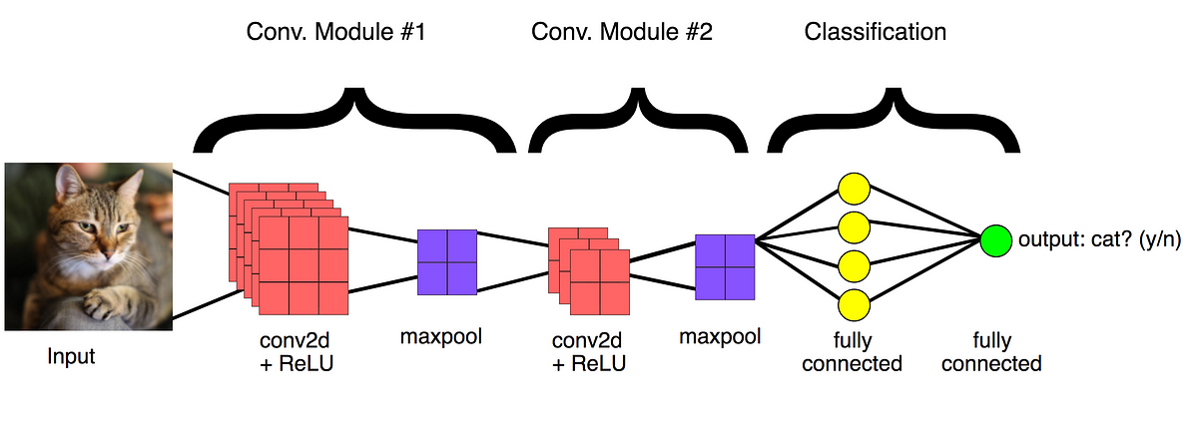
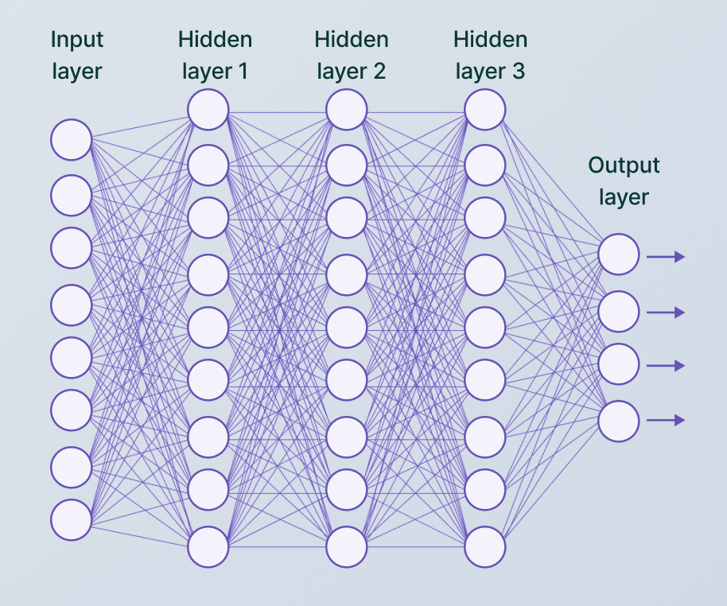
Background - Neural Network Application
Image classification using the TinyImageNet dataset
Utilizes 12 layer neural network to classify an image into 1 of 200 classes
Each layer is computationally heavy.
Thousands of data values loaded for every single inference
[7]
[8]
Notes:
Will

Slide 4
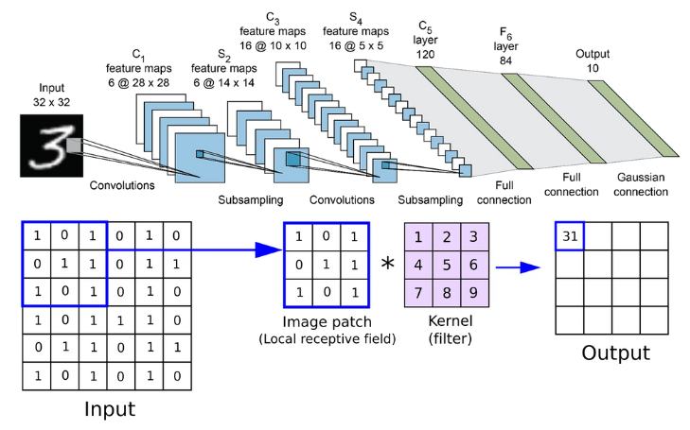
Background - Convolution Process
Evaluate strength of a filter to identify features in images
Higher number -> Higher presence of filter
Data Used:
Input Data (3D array)
Filter Data (4D array)
Output Data (3D array)
[9]
Notes:
Will

Slide 5
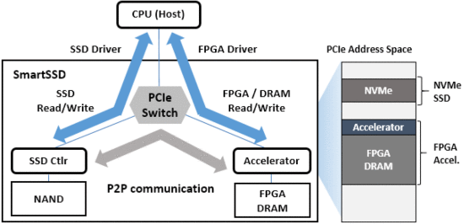
Background - SmartSSD
3.84 TB NAND Flash Samsung SSD [4]
NVMe Connection
AMD Kintex Ultrascale+ FPGA
Utilize Vitis to synthesize C
Reconfigurable
PCIe Switch between SSD, FPGA, and Host CPU
SmartSSD Architecture [5]
Notes:
Jake

Slide 6
Related Works - SmartSSD Accelerator
Common CPUs unable to utilize high bandwidth with multiple SSDs
Solution proposes to use SmartSSD for faster computations
Evaluates SparkSQL framework with TPC-H (benchmark)
Compare acceleration between CPU, external FPGA (Alveo U250) and SmartSSD [5]
Compares multiple results:
Execution Time Speedup
Performance Per Watt
CPU Utilization
Notes:
Jake

Slide 7
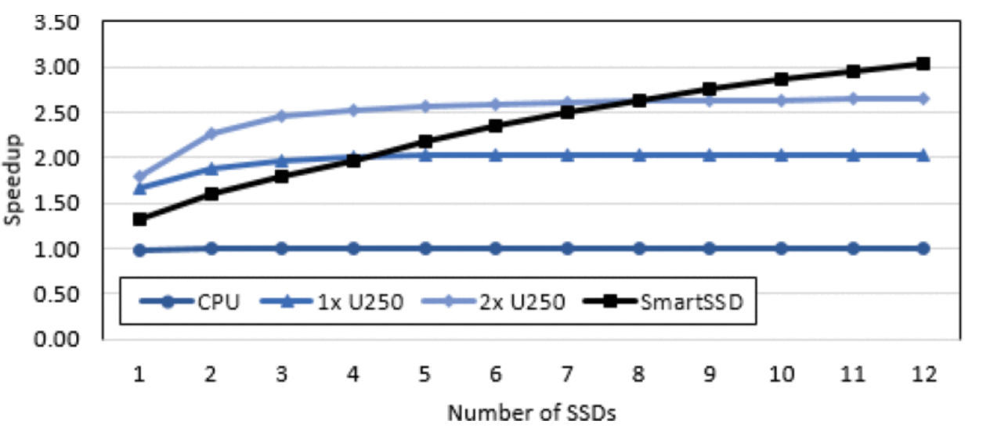
Related Works - SmartSSD Accelerator
Analyzes Speedup between baseline CPU, Alveo U250 accelerator cards, and SmartSSD
Analyzes with multiple SSDs
Large improvement with throughput of SmartSSD
External FPGA and SmartSSD Speedup Results [5]
Notes:
Jake

Slide 8
Related Works - NeSSA
Data movement can take as much as 80% of total time for warehouse-scale operations
Proposes near-storage acceleration model involving SmartSSD to reduce data movement
Select subsets of large datasets to train while maintaining accuracy
Uses multiple datasets to train model (includeTinyImageNet)
Analyzes accuracy of NeSSA training and time to train
Compares multiple subset sizes with other training models [6]
Notes:
Jake

Slide 9
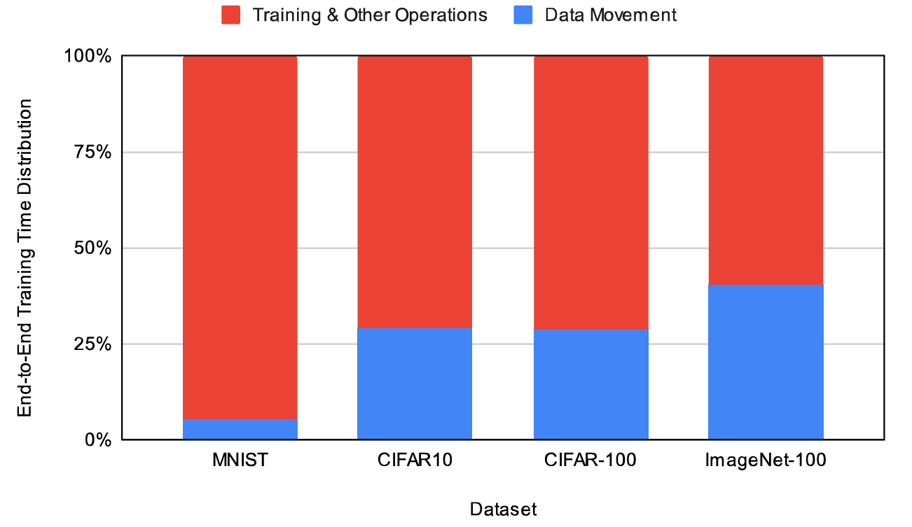
Related Works - NeSSA
Authors compare time spent on computation and data movement for multiple models
Demonstrates importance of improving Data Movement latency for future works
Percent of time Training Neural Networks Vs. Data Movement Latency for Machine Learning Models[6]
Notes:
Jake

Slide 10
Solution Approach
Run Neural Network application on Host Machine
Utilize existing CPRE487/587X library, gain baseline results
Convolution Kernel Synthesis
Refactor Convolution Layer to individual function
Synthesize Kernel in Vitis
Run Neural Network application on SmartSSD application
Compile with Vitis
Peer to Peer communication between SSD and FPGA
Optimize Kernel design and memory transactions to reduce latency
Notes:
Will

Slide 11
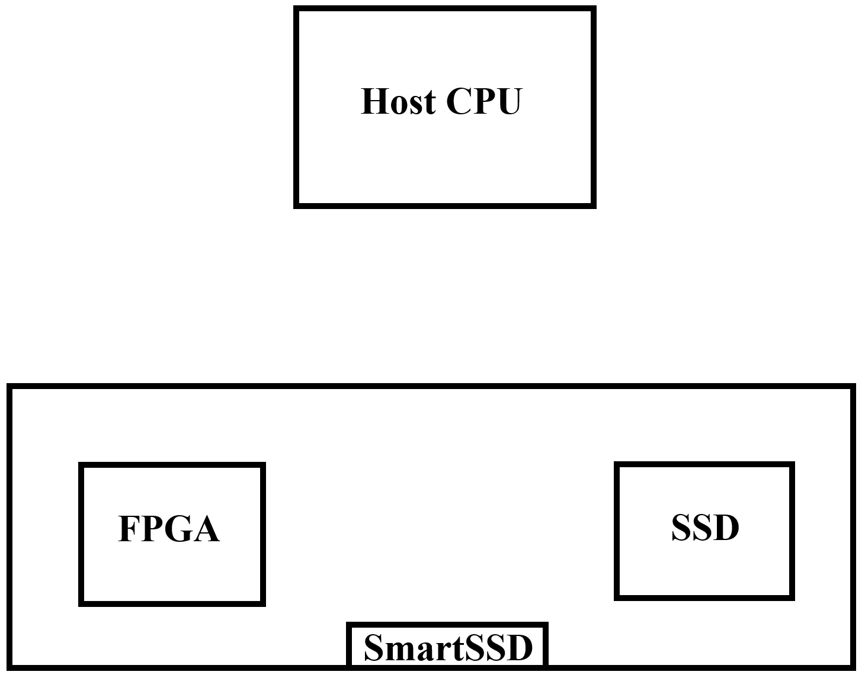
Host Process
Host Code Steps
Read Convolution inputs from SSD to Host
Compute Floating Point operations on Host CPU
Write resulting convolution output from Host to SSD
Step 2
Step 1
Step 3
Datapath
Control
Notes:
William

Slide 12
SmartSSD Process
Host Code Steps
Initialize Kernel and SmartSSD
Write convolution inputs from Host to SSD in fixed blocks
Read input arguments from SSD to FPGA
Activate Kernel
Write output from FPGA to SSD
Read value from SSD to Host to Verify
Step 1
Step 2
Step 3
Step 3
Step 4
Step 6
Step 5
Step 5
Step 3
Datapath
Control
Step 5
Step 4
Notes:
William

Slide 13
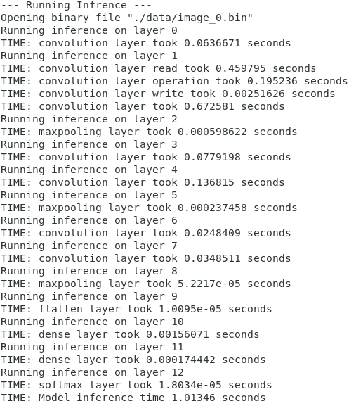
Neural Network with Host
Run baseline code on SmartSSD device WITHOUT FPGA
Majority of time spent on data movement
Reading takes majority of time: 0.459 seconds
Writing data has minimal overhead: 0.002 seconds
Computing FP operations takes 0.195 seconds
A single inference for a low-res test image takes 0.672 seconds
How can we reduce data movement with SmartSSD?
Notes:
Will

Slide 14
Convolution Kernel
Created separate class for Layer 2 Convolution
Enabled changes to Layer 2 while keeping rest of code same
Convolve operation moved to independent function
Called within the 3 level nested for loop
Created function for single point convolution
Flattened 3D and 4D arrays into 1D arrays for synthesis and interfacing
800 loop iterations to operate in kernel per call
Notes:
Jake

Slide 15
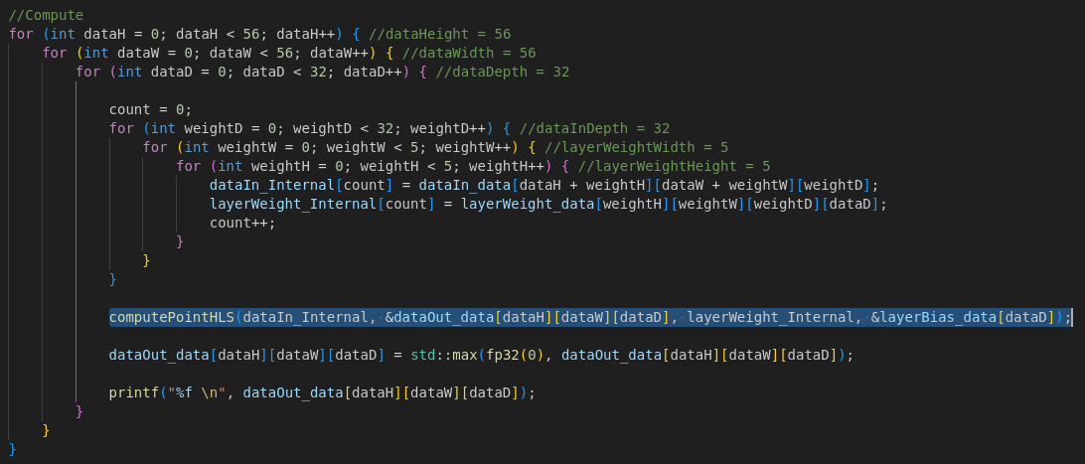
Convolution Kernel
Layer 2 Convolution Function
Notes:
Jake

Slide 16
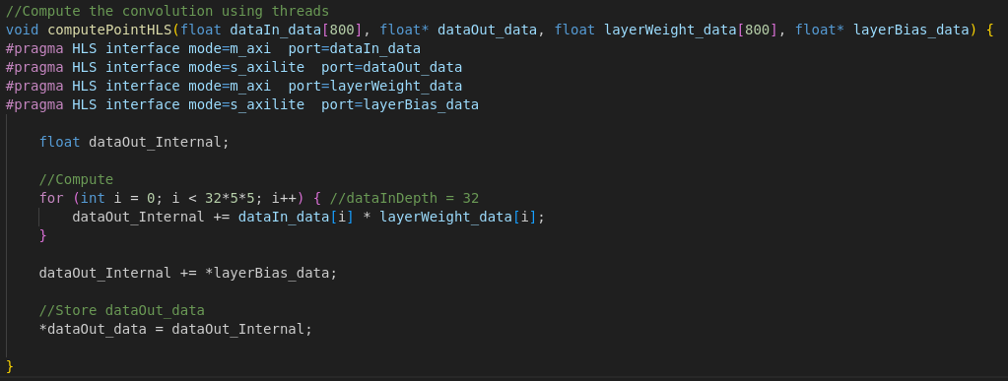
Convolution Kernel
Single Point Convolution Function, Target Kernel
Notes:
Jake

Slide 17
SmartSSD Application
Created Host code for Peer to Peer memory transactions between Host/SSD and SSD/FPGA
Synthesized Kernel code to run on SmartSSD FPGA
Verified expected kernel output of convolution point
Collected timing metrics with chrono C++ library
Inconsistent results for individual read/compute/write operations
SmartSSD Architecture [5]
Notes:
Jake

Slide 18
SmartSSD Optimization
Problem
Latency of FPGA kernel extremely slow
Memory transactions limited by 512 Byte minimum read/write size
Read/Write transactions not utilizing high bandwidth
Solution
Reduce amount of empty data read/write due to minimum block size to increase data bandwidth
Reduce Kernel latency by adding parallelization of single point
Compute multiple points in 1 kernel call to increase data bandwidth
Less read/write transaction overhead from host
Notes:
William

Slide 19
SmartSSD Optimization
Kernel Improvements
Old Kernel: 9107 cycles for 1 point
Final Kernel: 708,747 cycles for 1024 points, average 692 cycles for 1 point
Computes 1024 points per kernel call, loop unrolling with stride 32
Average 0.865 cycles per loop iteration with parallelization
Read Improvements
Old Host: Reads 4096 Values per point, Only 1602 Used
Final Host: Reads 1600 Values per point, Fully utilized
Write Improvements
Old Host: Writes 1024 Values per point, only 1 Used
Final Host: Writes 1 value per point, Fully utilized
Notes:
William

Slide 20
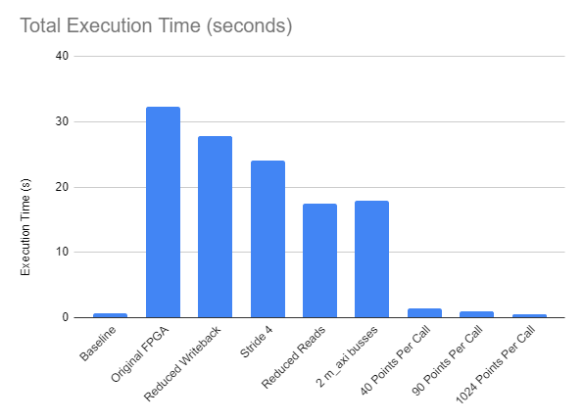
Results
Full Layer Baseline CPU: 0.662 seconds
Original SmartSSD: 32.246 seconds
48x SPEED DOWN
Large improvement when running multiple convolution operations in one kernel
Majority of time spent reading data from SSD and computing kernel
Notes:
William

Slide 21
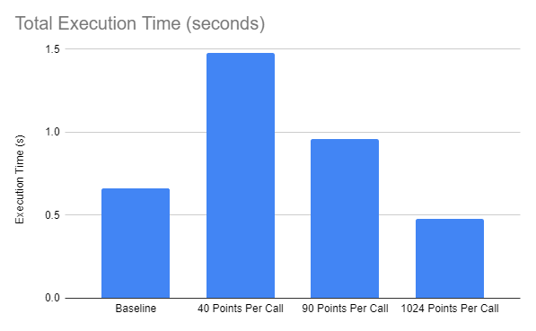
Results
Full Layer Baseline CPU: 0.662 seconds
1024 Points per Kernel: 0.4778 seconds
1.38x SPEED UP
More points per call ->
less latency overhead from kernel call control
Higher data bandwidth in read transactions
Notes:
William

Slide 22
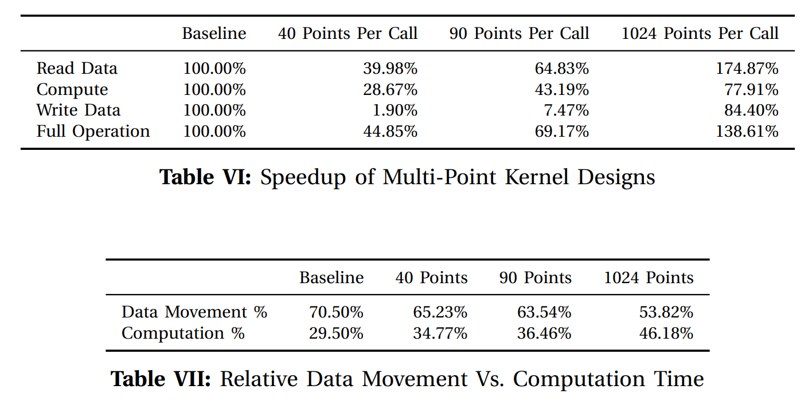
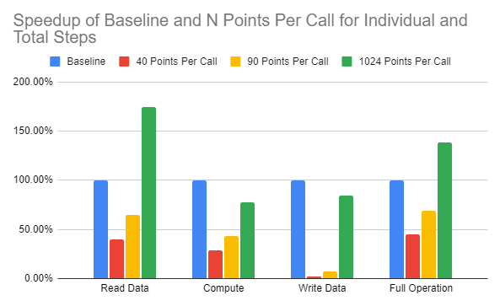
Results
Speedup normalized to Baseline CPU
Data read from SSD: 1.74X SPEED UP
Kernel computations still slightly slower than baseline, room for improvement with Vitis HLS
Data writes slower, due to low bandwidth transaction of 1 block writeback per 1024 points
Notes:
William

Slide 23
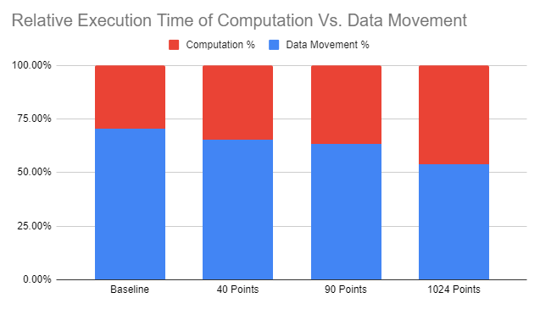
Results
Baseline CPU: 70.50% moving data
1024 Point: 53.82% moving data
As data bandwidth increases per N point operations, % data movement decreases
Final design also has lower data movement latency
Leaves more room for improvement in optimizing kernel or write transactions
Notes:
William

Slide 24
Analysis
Application specific designs will take tailoring to achieve performance benefits, as seen with original FPGA design
SmartSSD can provide speedup in terms of overall execution time while lowering the gap between data movement and computation time
Designs benefit from high bandwidth applications and parallelization of FPGA design
Notes:
William

Slide 25
Future Work
Potential improvement for computation time of floating point operations in FPGA kernel
More parallelization, compute 1024 points faster
Could speed up writeback by increasing write bandwidth larger than 1 4KB block
Store full layer of points then write back with one write transaction
Notes:
William

Slide 26
References
[1] J. Do, V. C. Ferreira, H. Bobarshad, M. Torabzadehkashi, S. Rezaei, A. Heydarigorji, D. Souza, B. F. Goldstein, L. Santiago, M. S. Kim, P. M. V. Lima, F. M. G. França, and V. Alves, “Cost-effective, energy-efficient, and scalable storage computing for large-scale ai applications,” ACM Trans. Storage, vol. 16, oct 2020.
[2] D. Fakhry, M. Abdelsalam, M. W. El-Kharashi, and M. Safar, “A review on computational storage devices and near memory computing for high performance applications,” Memories - Materials, Devices, Circuits and Systems, vol. 4, p. 100051, 2023.
[3] https://miro.medium.com/max/700/1*oB3S5yHHhvougJkPXuc8og.gif
[4] https://www.xilinx.com/applications/data-center/computational-storage/smartssd.html
[5] J. H. Lee, H. Zhang, V. Lagrange, P. Krishnamoorthy, X. Zhao and Y. S. Ki, "SmartSSD: FPGA Accelerated Near-Storage Data Analytics on SSD," in IEEE Computer Architecture Letters, vol. 19, no. 2, pp. 110-113, 1 July-Dec. 2020, doi: 10.1109/LCA.2020.3009347. keywords: {Field programmable gate arrays;Bandwidth;Random access memory;IP networks;Pipelines;Data analysis;Throughput;SmartSSD;data analytics;spark;parquet;SSD}
[6] Neha Prakriya, Yu Yang, Baharan Mirzasoleiman, Cho-Jui Hsieh, and Jason Cong. 2023. NeSSA: Near-Storage Data Selection for Accelerated Machine Learning Training. In Proceedings of the 15th ACM Workshop on Hot Topics in Storage and File Systems (HotStorage '23). Association for Computing Machinery, New York, NY, USA, 8–15. https://doi.org/10.1145/3599691.3603404
[7] https://miro.medium.com/v2/resize:fit:1200/1*QnKckNSZilG3HxytJZUoAw.png
[8] https://assets-global.website-files.com/5d7b77b063a9066d83e1209c/627d1225cb1b3d197840427a_60f040a887535b932a3b2b6e_cnn-hero%2520(1).png
[9] https://assets-global.website-files.com/614c82ed388d53640613982e/646371e3bdc5ca90dee5331b_convolutional-neural-network%20(1).webp

Slide 27

Questions

Slide 28
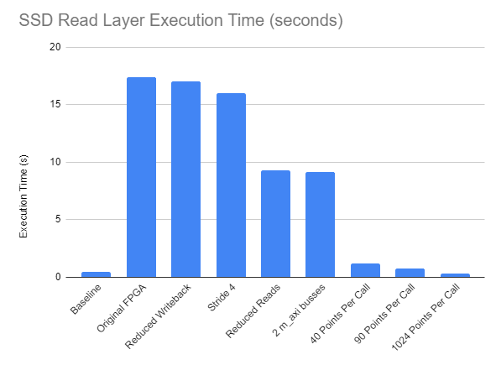
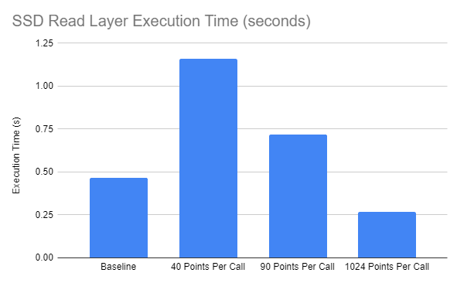
Supplemental

Slide 29
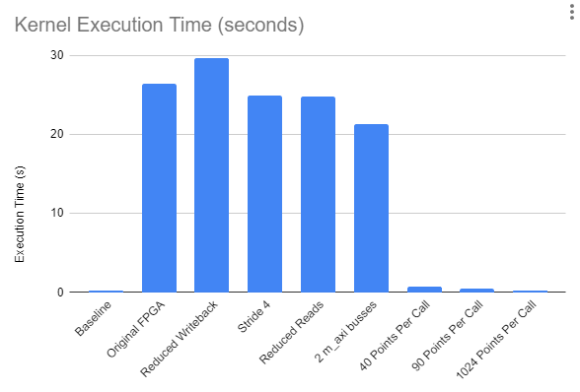
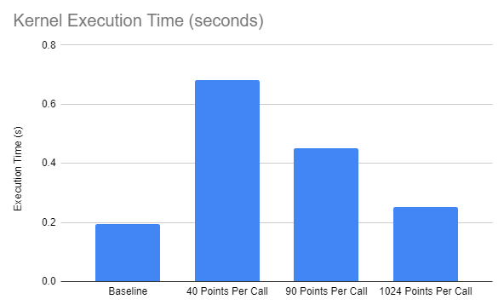
Supplemental

Slide 30
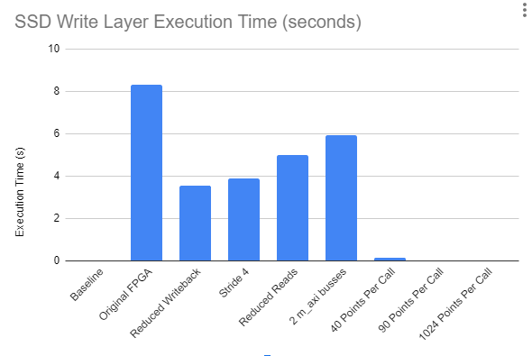
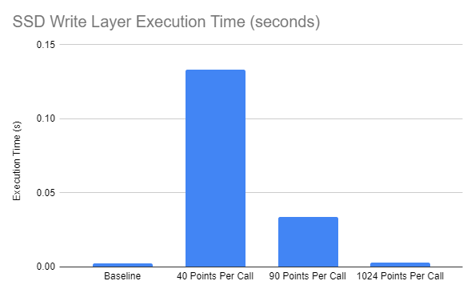
Supplemental

Slide 31
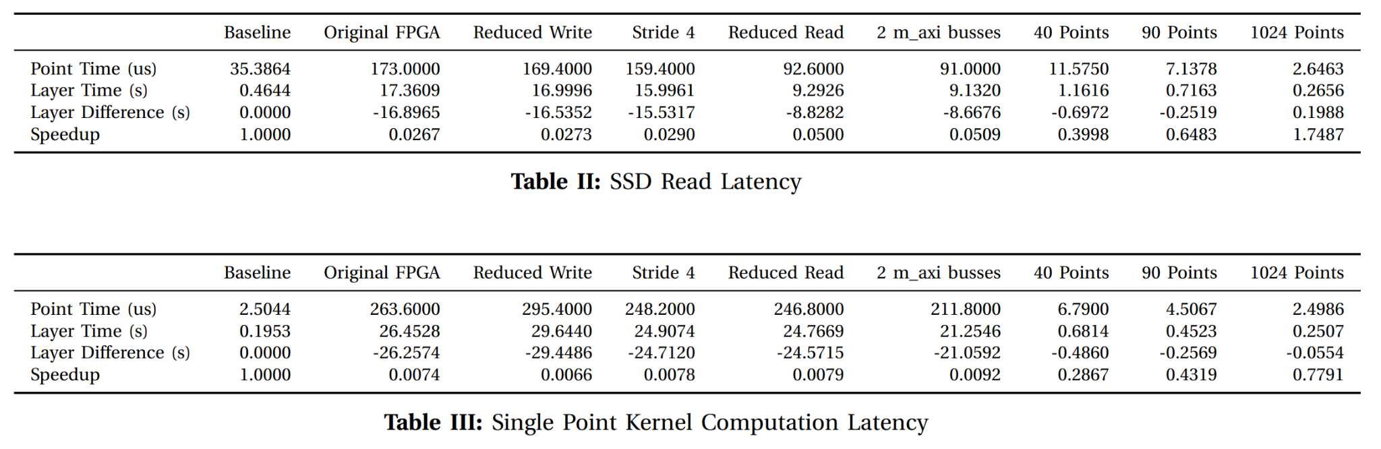
Supplemental

Slide 32
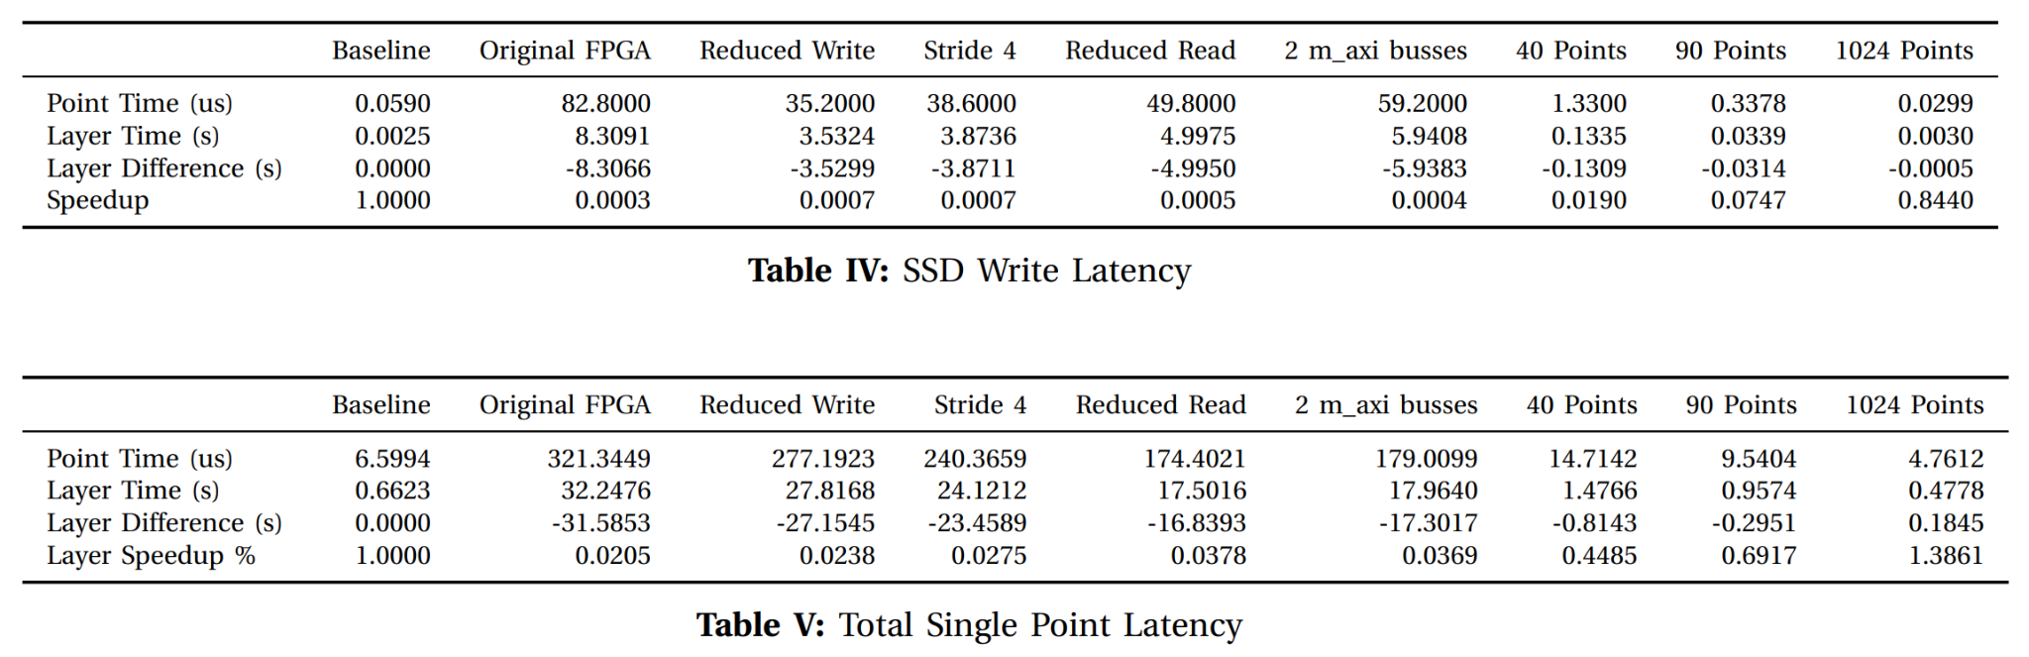
Supplemental

Slide 33
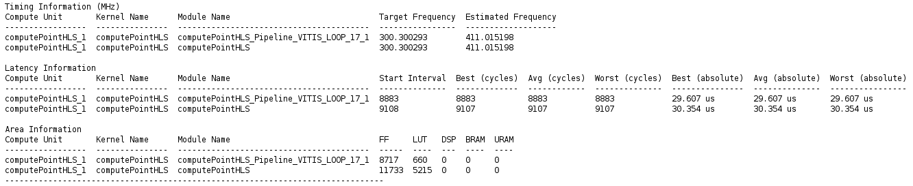
Supplemental
Original Kernel Latency Delays
Final Kernel Latency Delays

Slide 34
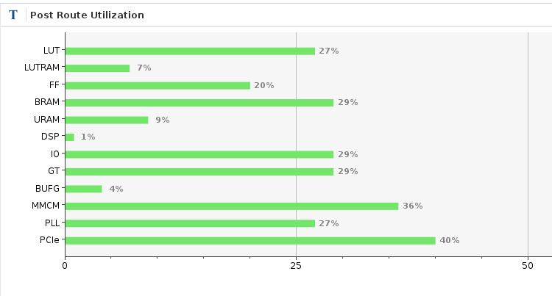
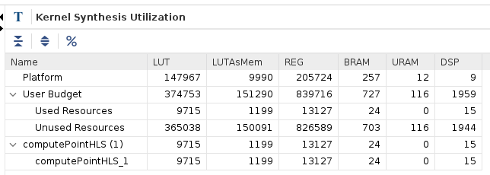
Supplemental
Final Kernel Utilization

Slide 35
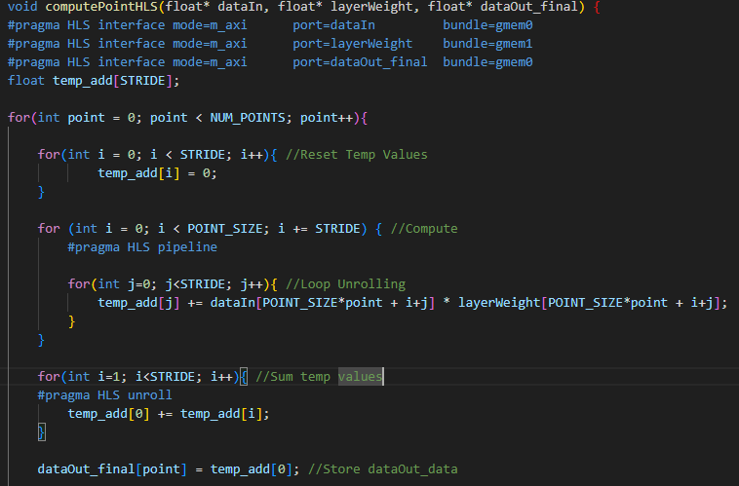
Supplemental
Final Kernel Code

Slide 36
Supplemental
Write to SSD From Host
Read from SSD to Host

Slide 37
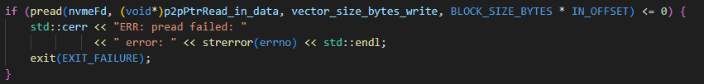
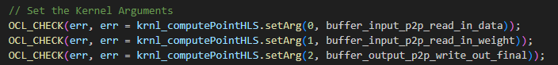
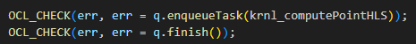
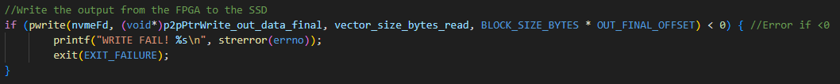
Supplemental
Read from SSD to FPGA
2. Set Input Arguments for Kernel to buffer pointers
3. Call FPGA Kernel
4. Write to SSD from FPGA

